Slide 1

Simple
Business
Solution

Slide 2
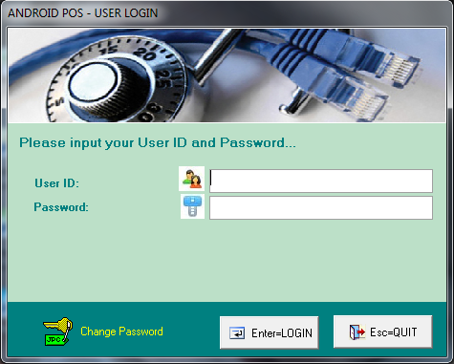

Slide 3
